Slide 1
Introduction to Spark and Scala
INF 553
University of Southern California

Slide 2
Outline
How to write Spark program (syntax)
Key concepts in spark
Speed program up
Install Spark on your machine
Vocareum.com, use Spark on their terminal window
Reading materials and links

Slide 3
Resilient Distributed Dataset (RDD)
Distributed
Data are split into multiple partitions, distributed across nodes to be processed in parallel
Resilient
Spark keeps track of transformations and enable efficient recovery
Built-in data structure
You can’t access the value directly in pyspark

Slide 4
Partitions
Data are split into multiple partitions by hashing function
Ensure the partitions are balanced
Common size of a partition is 64MB, common number of partition is 2 or 3 times of the #workers
Less partition sometimes may lead to better performance because of the cost of “partition”
Repartition(func, num)

Slide 5
Shuffling
Handle shuffling carefully to speed you program up!
Data are essentially repartitioned during shuffling.
E.g. sort by key

Slide 6
RDD Operations
Transformations
They are lazy, the result is not immediately computed
Actions
They are eager, the result is immediately computed

Slide 7
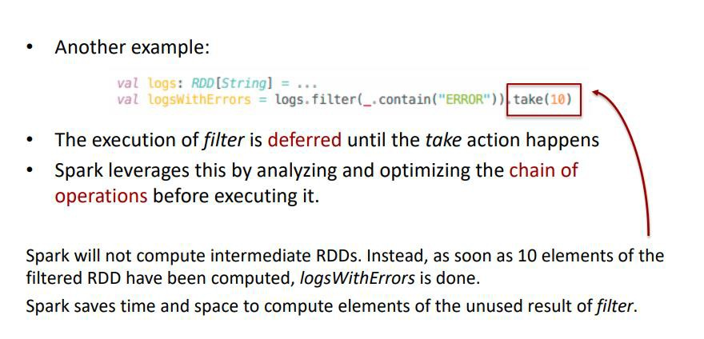
Benefits of Laziness

Slide 8
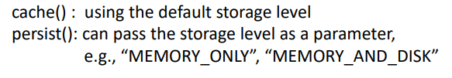
Caching and Persistence
By default, RDDs are recomputed each time you run an "action" on them. This can be expensive (time-consuming) if you need to use a dataset more than once
Spark allows you to control what is cached in memory. use persist() or cache()

Slide 9
Common "Transformations” on RDD
map(func)
mapValues(func)
filter(func)
flatMap(func)
reduceByKey(func, [numTasks])
groupByKey([numTasks])
sortByKey([asc], [numTasks])
distinct([numTasks])
mapPartitions(func)

Slide 10
Common ”Actions” on RDD
getNumPartitions()
foreachPartition(func)
collect()
take(n)
count(), sum(), max(), min(), mean()
reduce(func)
aggregate(zeroVal, seqOp, combOp)
countByKey()

Slide 11
Why Use Spark Operations?
Technically, one can implement in Python most of operations by map/flatMap by embedding the statement into the input func in Python
Spark is implemented by Java, runs in jvm, so it is faster than Python
Spark can analyze and optimize the computing process

Slide 12
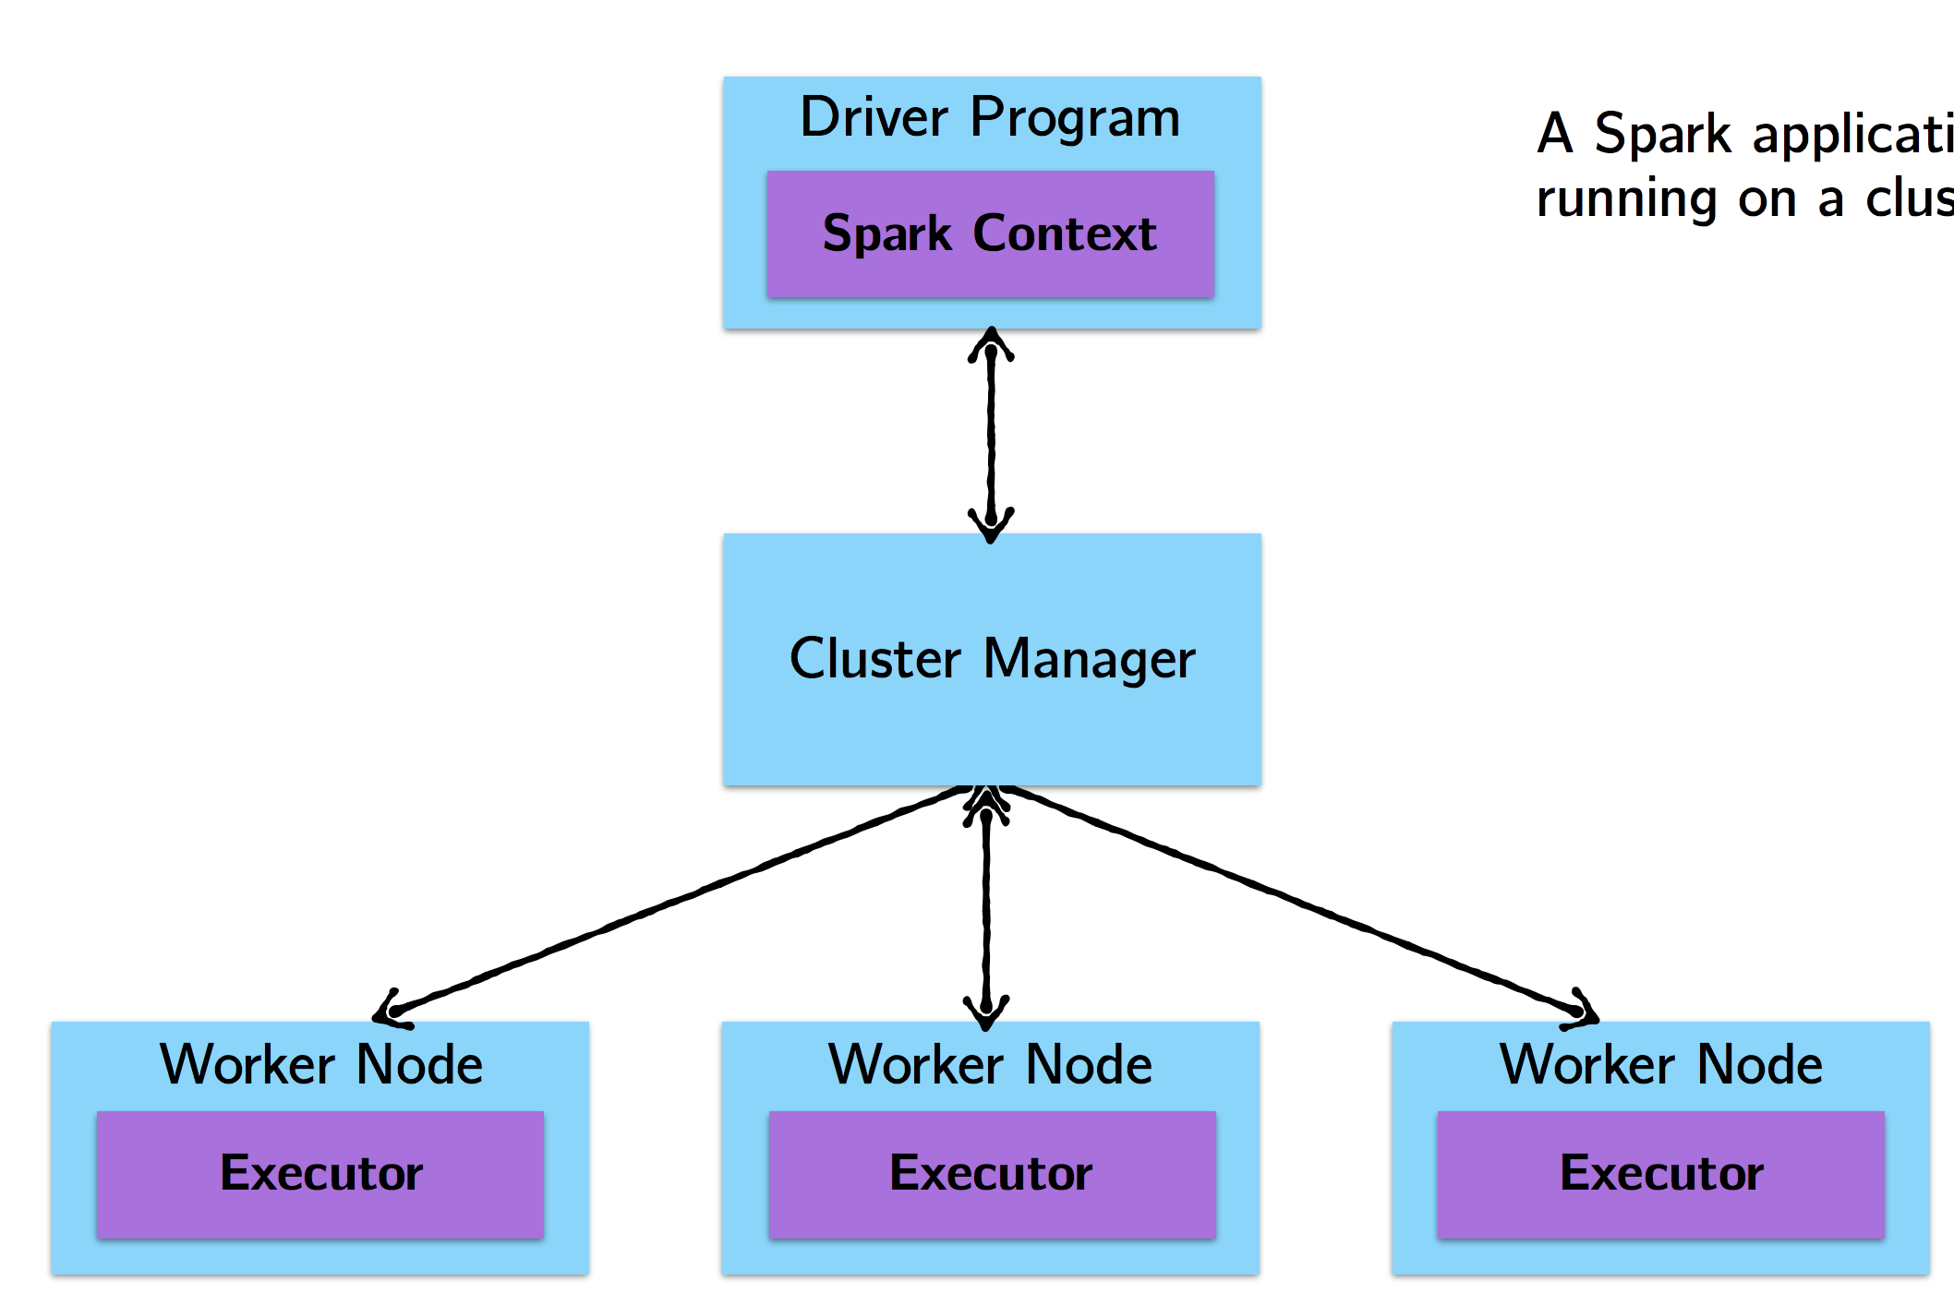

How Spark jobs are Executed?
Steps of executing a Spark program:
The driver program runs the Spark application, which creates a SparkContext.
The SparkContext connects to a cluster manager to allocate resources
Spark acquires executors on nodes in the cluster, which run computations for your application.
Driver program sends your application code to executors to execute.
12

Slide 13
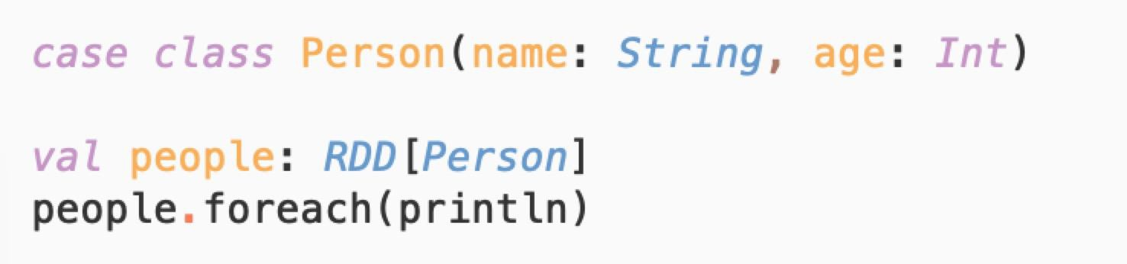
Cluster Topology
A simple example with println
What happens?
13

Slide 14
Cluster Topology
A simple example with println
On the driver: Nothing.
Why? Recall that foreach is an action, with returns type Unit. Therefore, it will be eagerly executed on the executors. Thus, any calls to println are happening on the worker nodes and are not visible in the drive node.
14

Slide 15
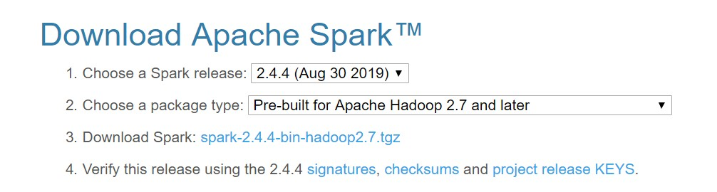
Install Spark
Download Spark from official website: http://spark.apache.org/downloads.html

Slide 16
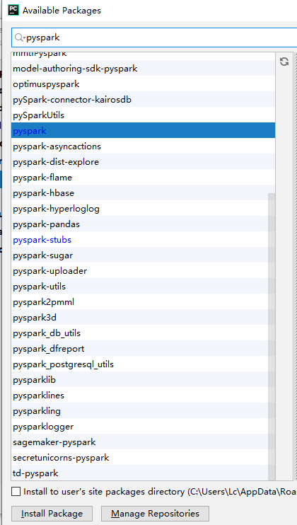
Pyspark
Pycharm is recommended
You can use pip install pyspark
Or config in PyCharm:
- click[Run] -> [Edit Configurations] -> Add[Environment variables]
Install pyspark package
Make sure keep the same python
version for driver and worker

Slide 17
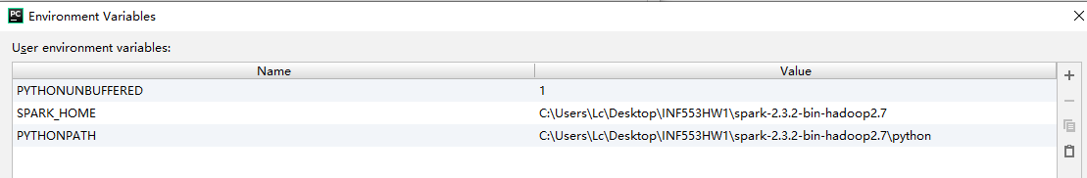
Set environment variables
SPARK_HOME
The root address of your downloaded spark folder
PYTHONPATH
The address of “python” folder under your SPARK_HOME address

Slide 18
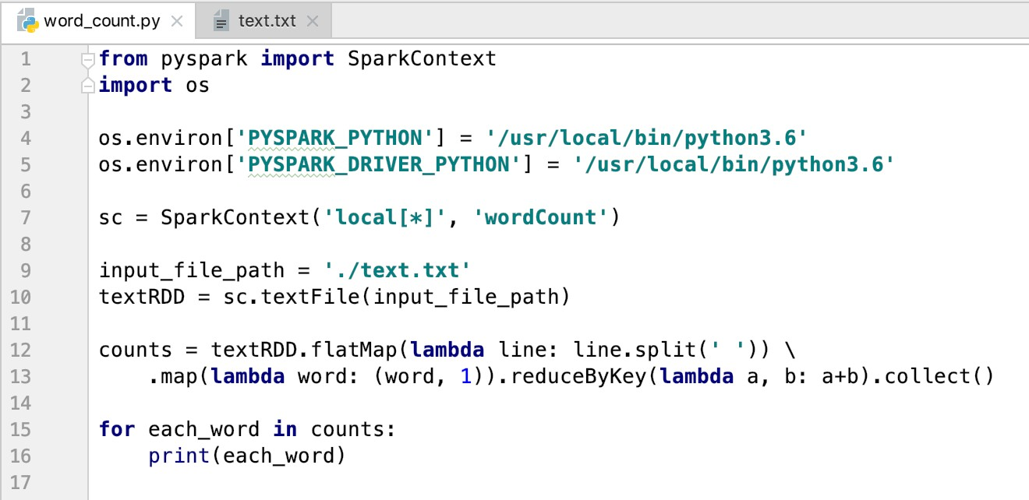
Sample Code

Slide 19
Run Python on Spark command line
Make sure keep the same python version for driver & worker
Edit ./conf/spark-env.sh (copy from ./conf/spark-env.sh.template)
Add environment variables
On the command line, you can do:
bin/spark-submit ./word_count.py
Try this on a terminal window
On your local machine
On Vocareum terminal window
19

Slide 20
Run Spark on Vocareum
Login to Vocareum.com
Got to the terminal window, and type:
/home/local/latest/spark/bin/spark-submit ./word_count.py
19

Slide 21
Install Scala
IntelliJ IDEA, the compiler: https://www.jetbrains.com/idea/
Install Scala plugin in the compiler
Open Preference -> Choose [Plugins] -> Click [Install JetBrains plugin] (at bottom) -> Search Scala and Install

Slide 22
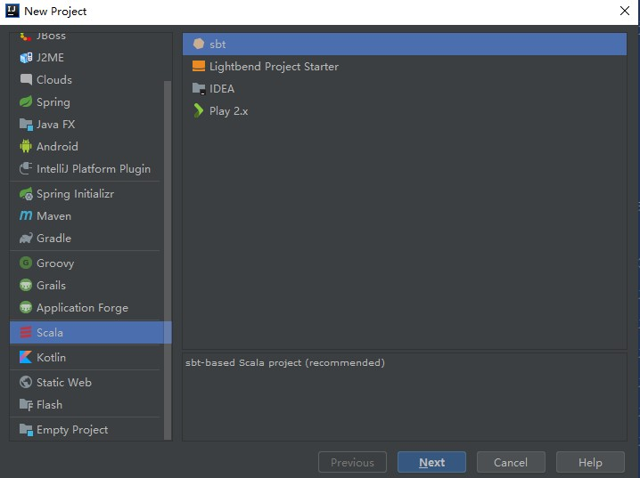
Create an SBT project

Slide 23
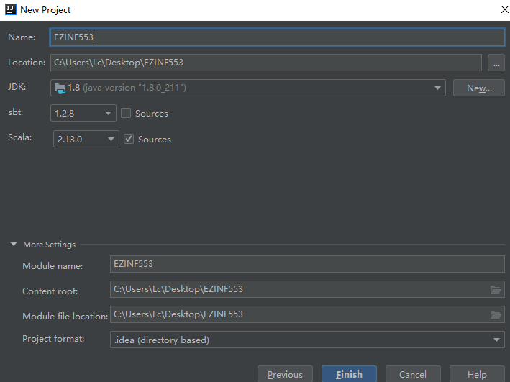
Create an SBT project

Slide 24
Add Spark Environment
You can add Spark either in External Libraries or through build.sbt
External Libraries:
Click [File] -> [Project Structure] -> [Libraries] -> [+] Java library ->
Add the jar package/.jar file from the Spark you download

Slide 25
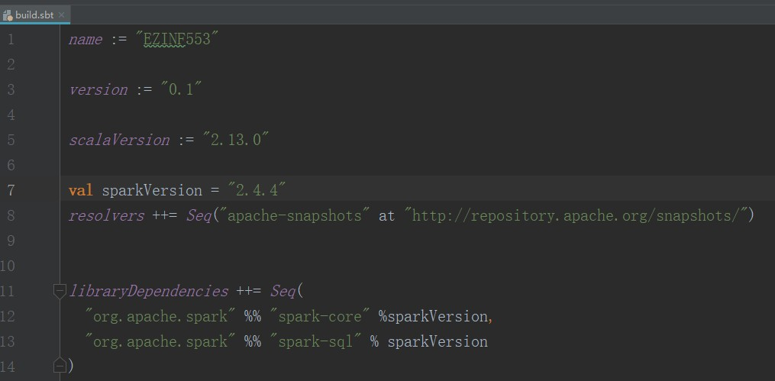
Add Spark Environment

Slide 26
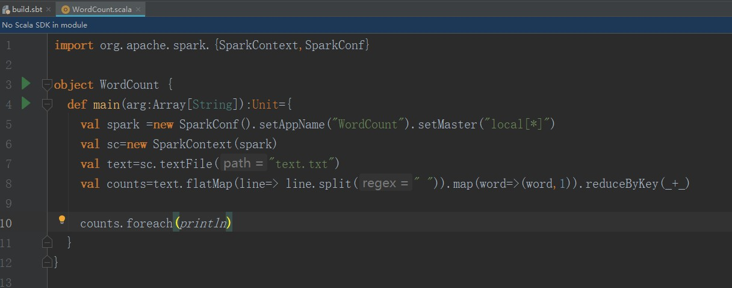
Write Scala Code
On the Project panel on the left, expand src => main
Right-click scala and select New => Scala Object

Slide 27
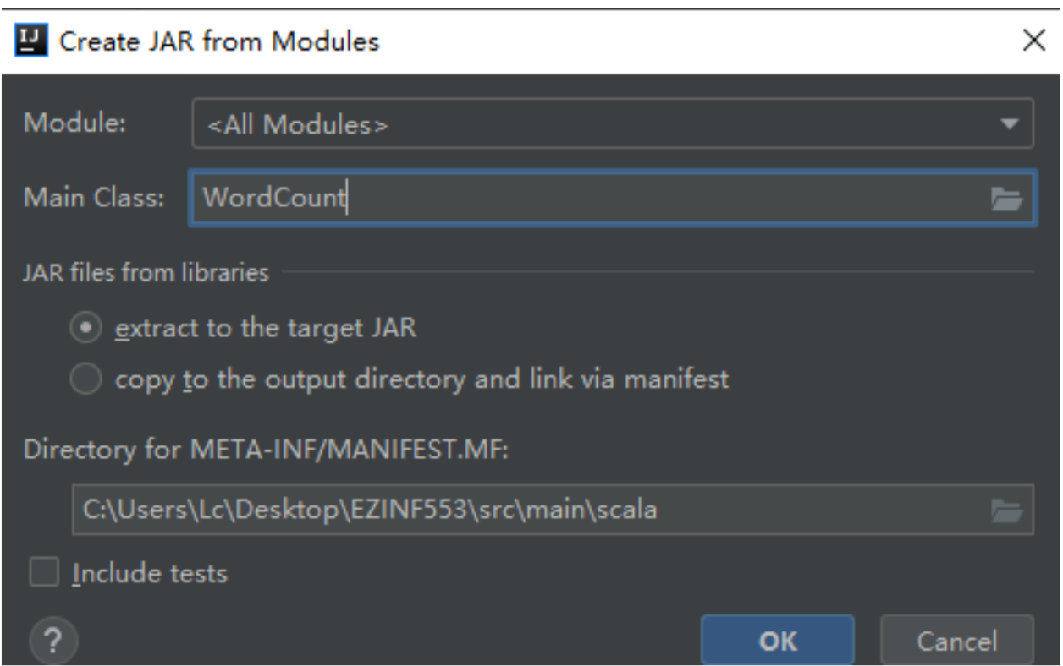
Build jar
Click [File] -> [Project Structure] -> [Artifacts] -> [+] JAR -> [From modules with dependencies] -> Put the Main Class of your code -> [OK]

Slide 28
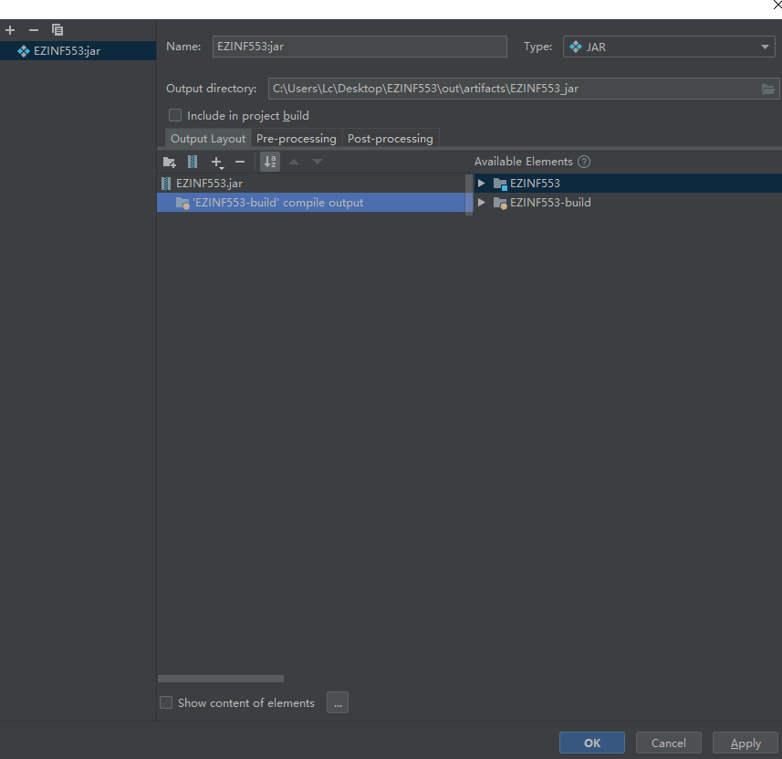
Build jar
You need to delete all the spark libraries or other unrelated libraries that you would not use in your program, otherwise your jar will be huge. Click[OK]
Click [Build] -> [Build Artifacts] -> [Build] -> produce the package out, the jar file is in it!

Slide 29
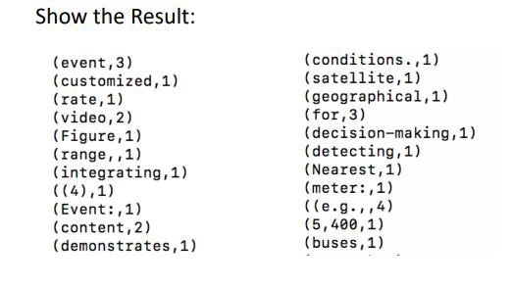
Run jar on Spark
bin/spark-submit –class wordcount ./****/wordcount.jar

Slide 30
Links
Please read the complete list of operations:
http://spark.apache.org/docs/latest/api/python/pyspark.html
Please read Spark Programming Guide:
https://spark.apache.org/docs/latest/

Slide 31
Attachments

Slide 32
Common Actions
getNumPartitions()
foreachPartition(func)
collect()
take(n)
count(), sum(), max(), min(), mean()
reduce(func)
aggregate(zeroVal, seqOp, combOp)
countByKey()

Slide 33
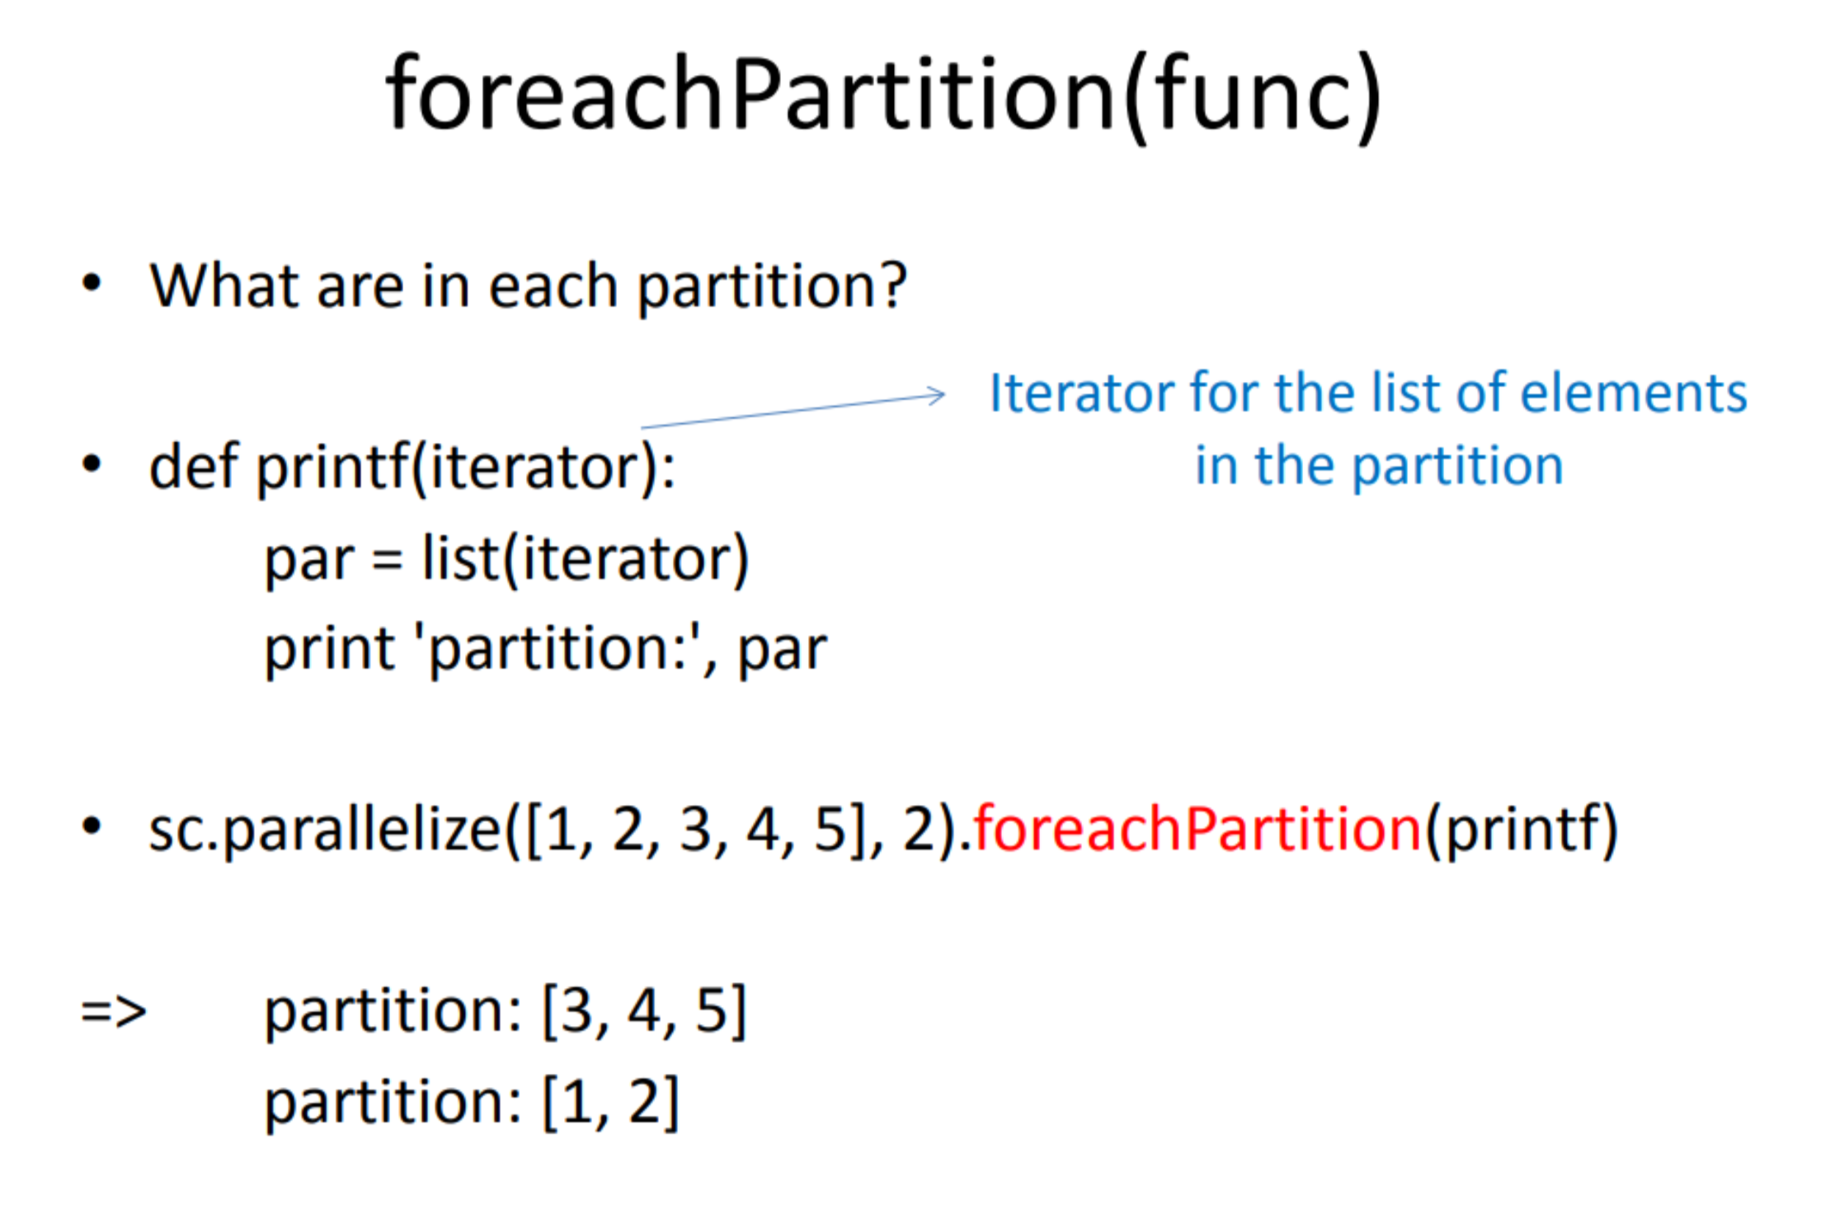

Slide 34
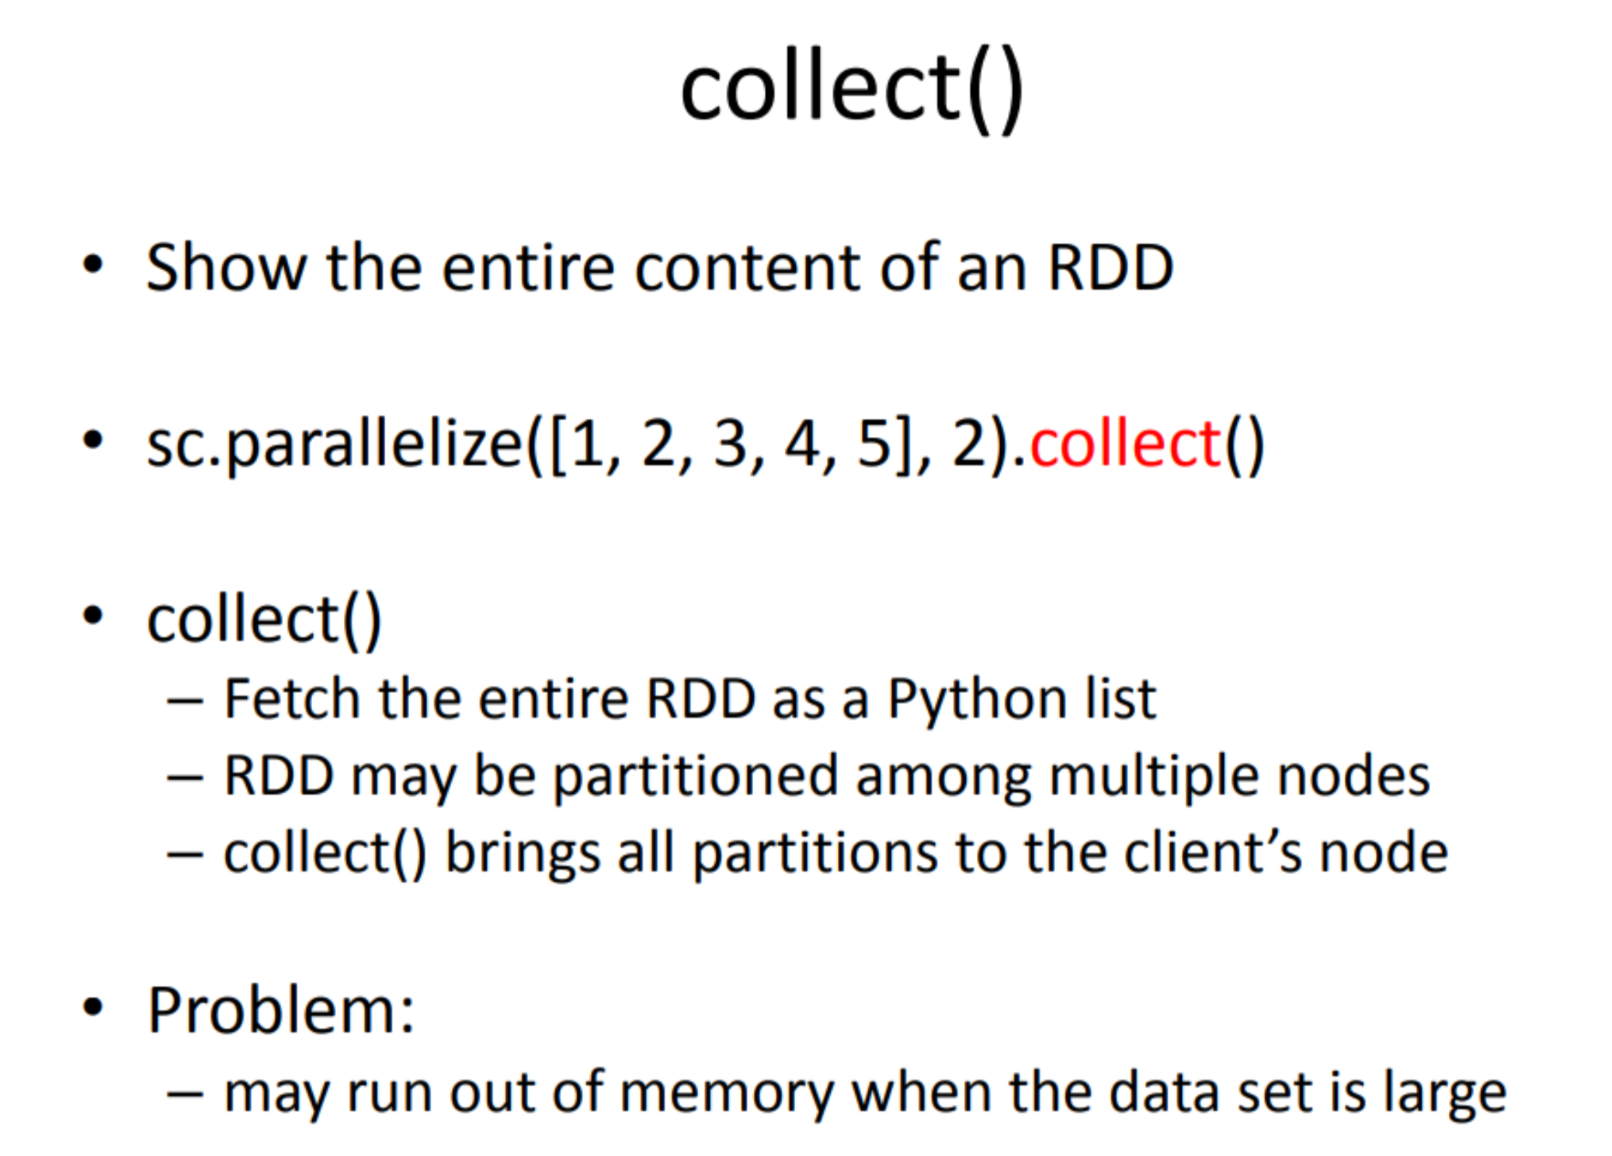

Slide 35
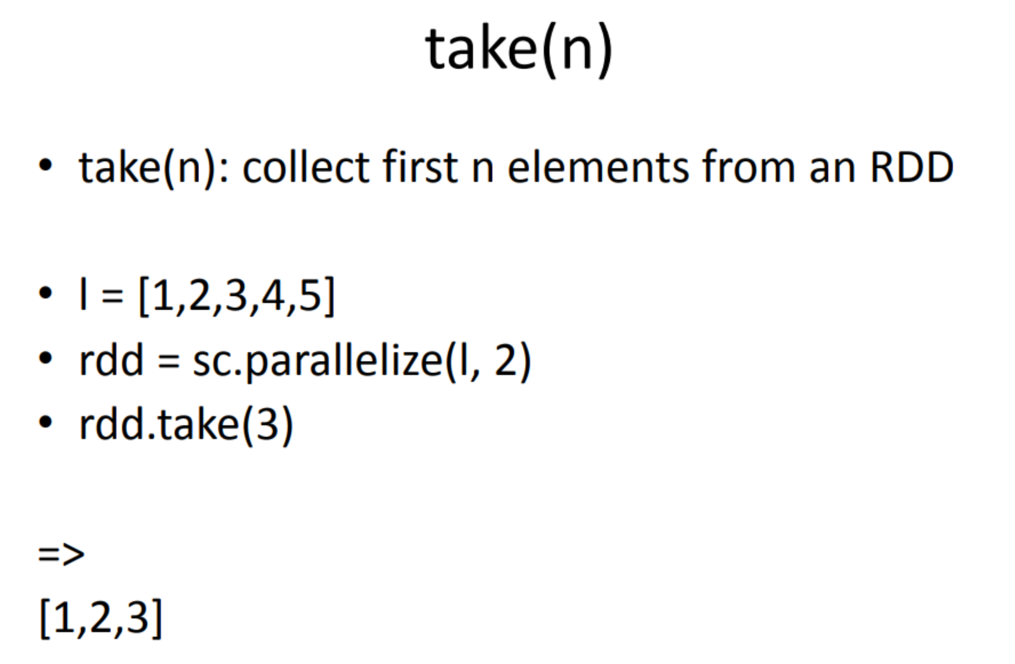

Slide 36
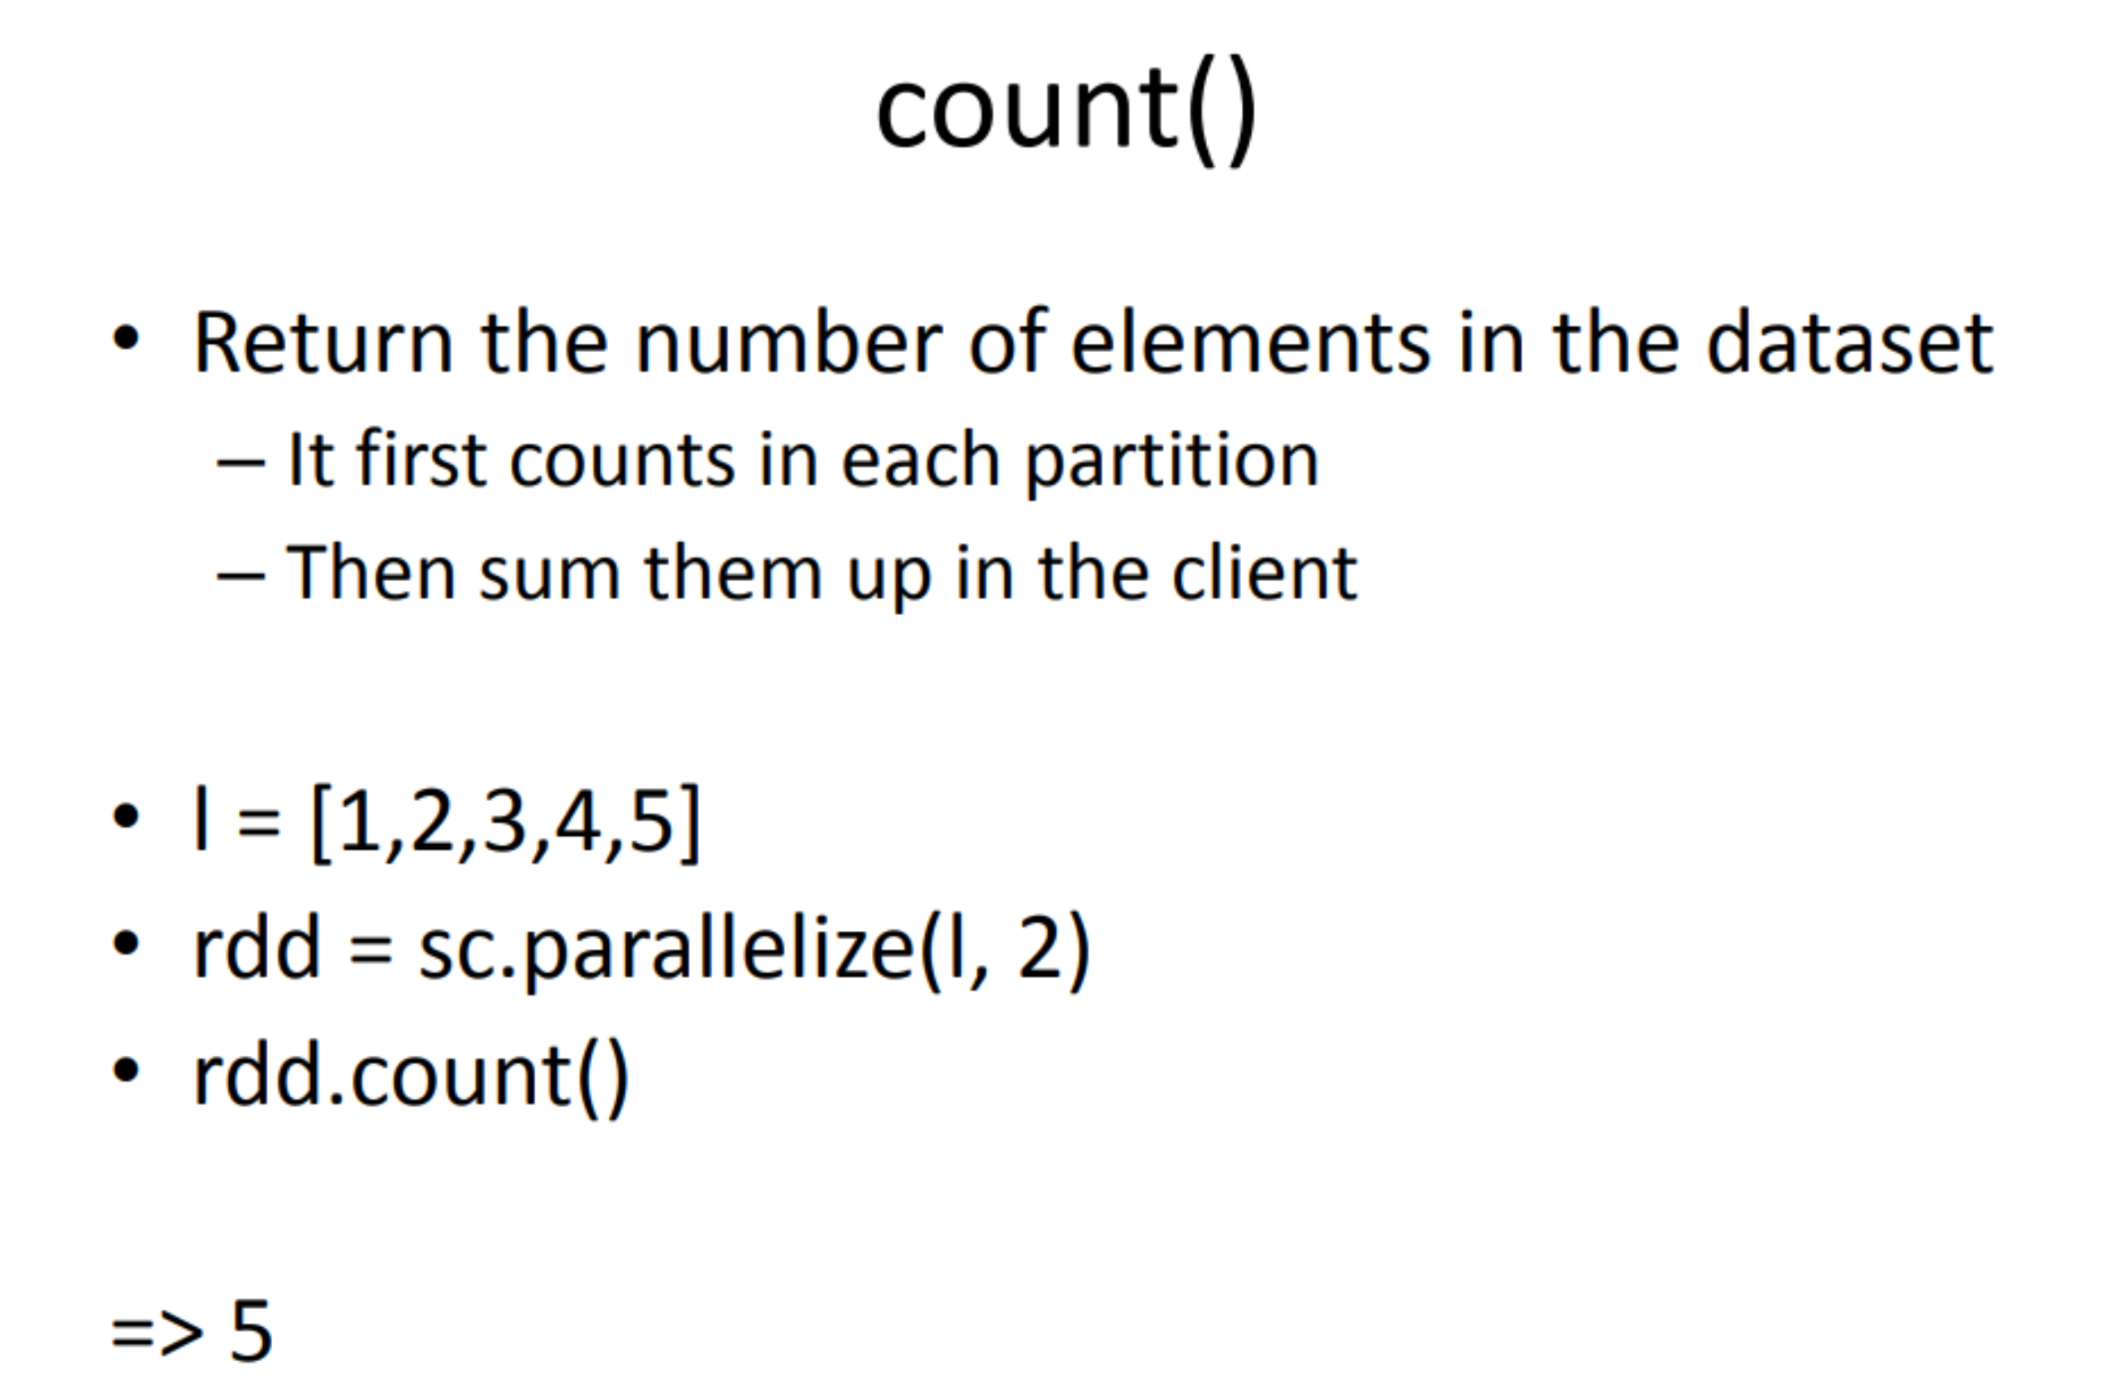

Slide 37
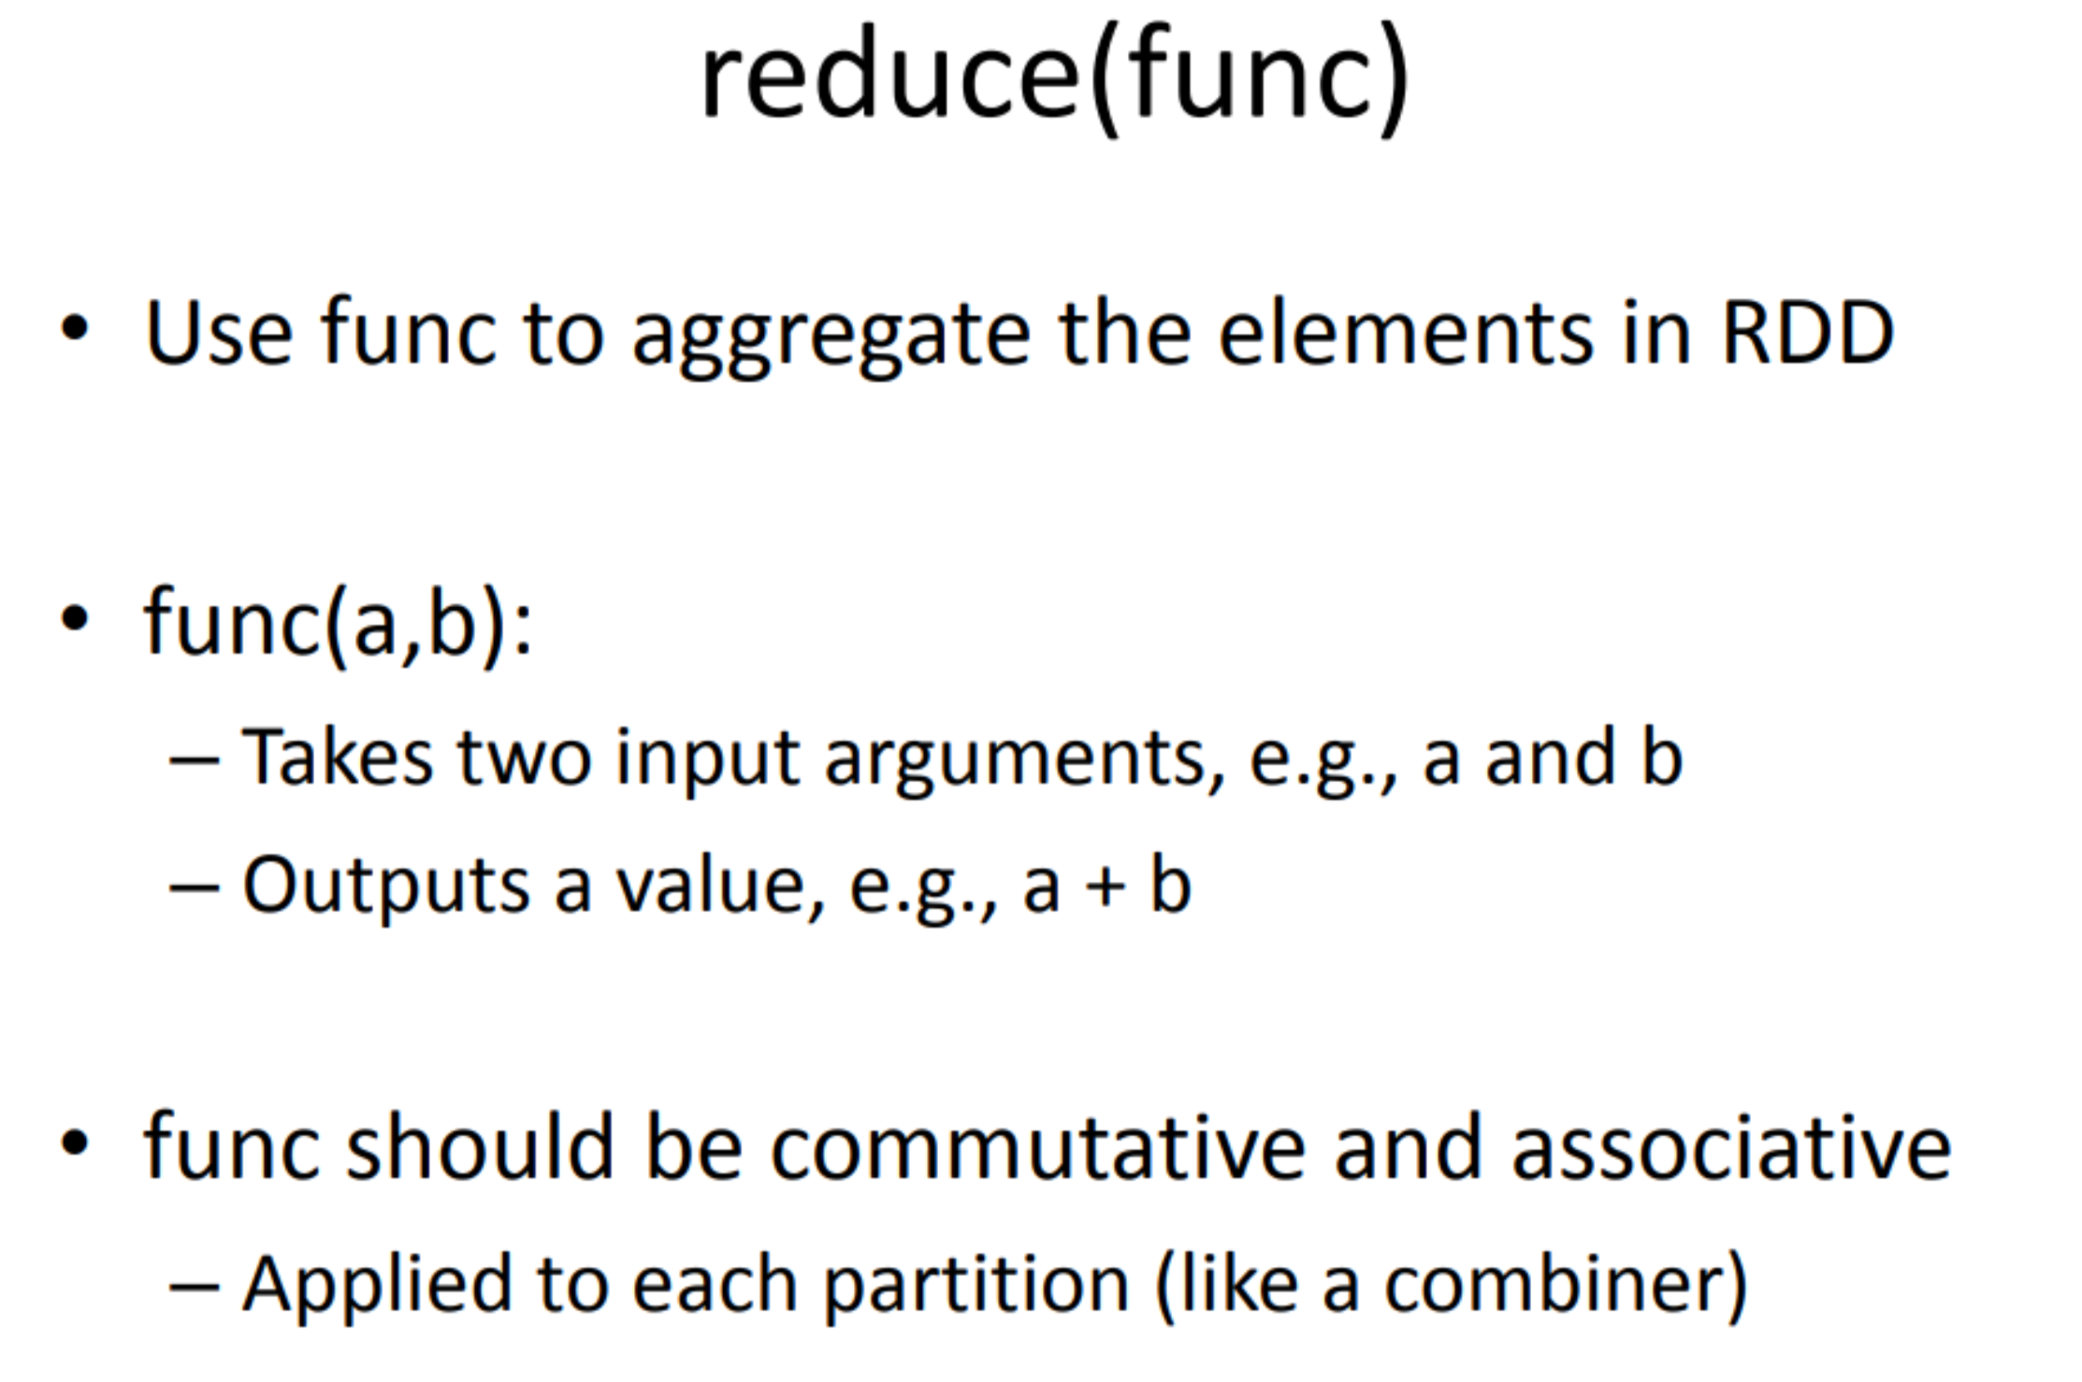

Slide 38
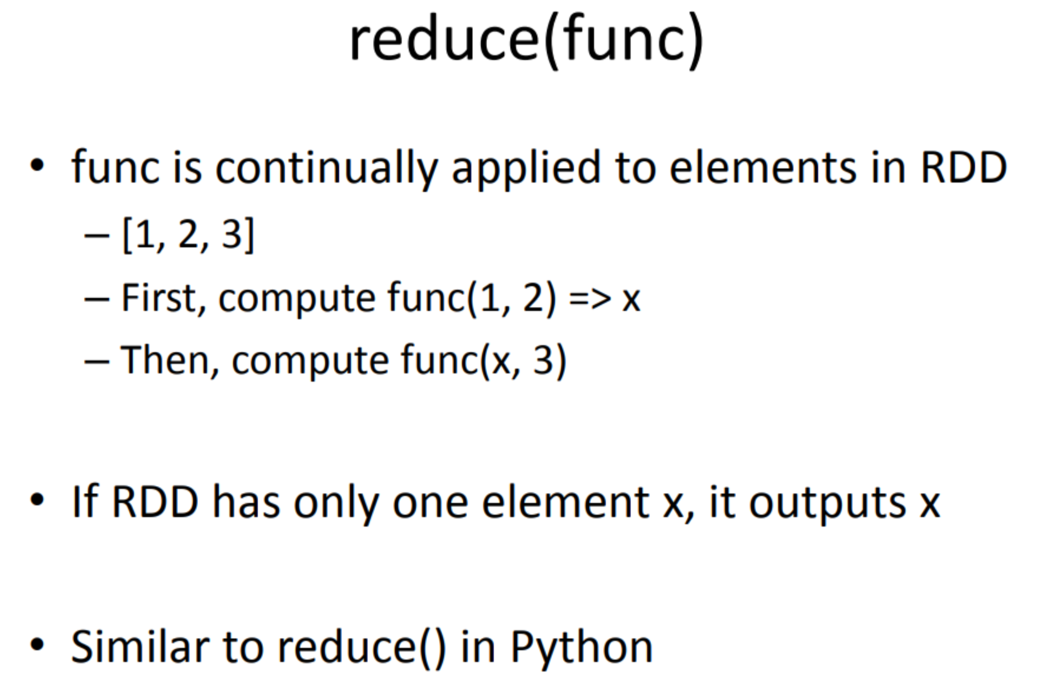

Slide 39
Exa mple: finding la rgest integers
• data = [S,4, 4, 1, 2, 3, 3, 1, 2, 5,4, S]
pdata = sc.parallelize( data)
pdata .reduce( lambda x,y: max(x,y))
=> 5

Slide 40
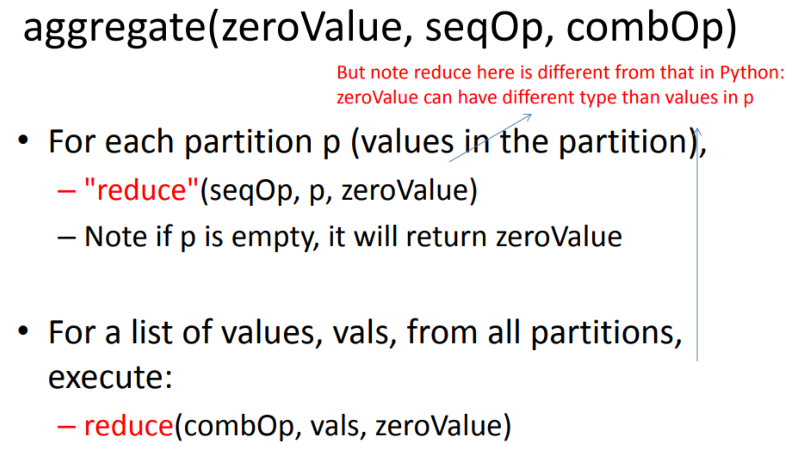

Slide 41
Exa mple
data = sc.parallelize( [1],2)
data.foreachPa rtition( printf)
- Pl: []
- P2: [1]
data.aggregate(1, add,add)
- Pl => [1] => after reduction => 1
- P2 => [1] + [1] = [1,1] => 2
- fina l: [1] + [1,2] => [1,1,2] => 4

Slide 42
Exa mple
data.aggregate(2, add, lambda U,v: U * v)
- Pl => 2
- P2 => 3
- FinaI: [2] + [2,3] => 2 * 2 * 3 = 12
(w here [2] is zeroVa lue,[2,3] is the list of va lues from partitions)

Slide 43
Common Transformations
map(func)
mapValues(func)
filter(func)
flatMap(func)
reduceByKey(func, [numTasks])
groupByKey([numTasks])
sortByKey([asc], [numTasks])
distinct([numTasks])
mapPartitions(func)

Slide 44
map(func)
map(func): Apply a function func to each element in input RDD
- func returns a va lue (could be a list)
Output the new RDD conta ining the transformed va lues produced by func

Slide 45
Exa mple
lines = sc.textFile("hello.txt ")
lineSplit = lines.map(lambda s: s.split())
=> [['hello','world' ], ['hello', 'this', 'world' ]]
linelengths = lines.map(lambda s: len(s))
=> [11, 16]

Slide 46
ma pPartitions(fu nc)
Apply transformati on to a partition
input to func is an iterator (over the elements in the partition)
func must return an itera ble (a list or use yield to return a generator)
Different from map(func)
func in map(func) applies to an element

Slide 47
f l atMap(func)
flat Map(func):
similar to map
But func here must return a list (or generator) of elements
- & flatMap merges these lists into a single list
lines.flatMa p(lambda x: x.split())
=>rdd: ['hello', 'world','hello','this','world' ]

Slide 48
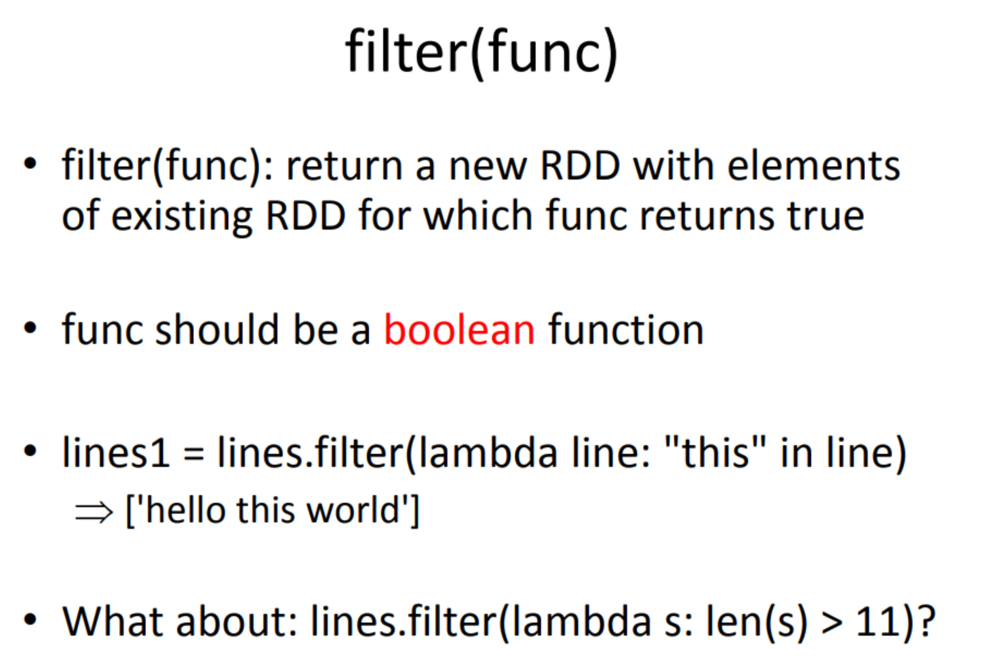

Slide 49
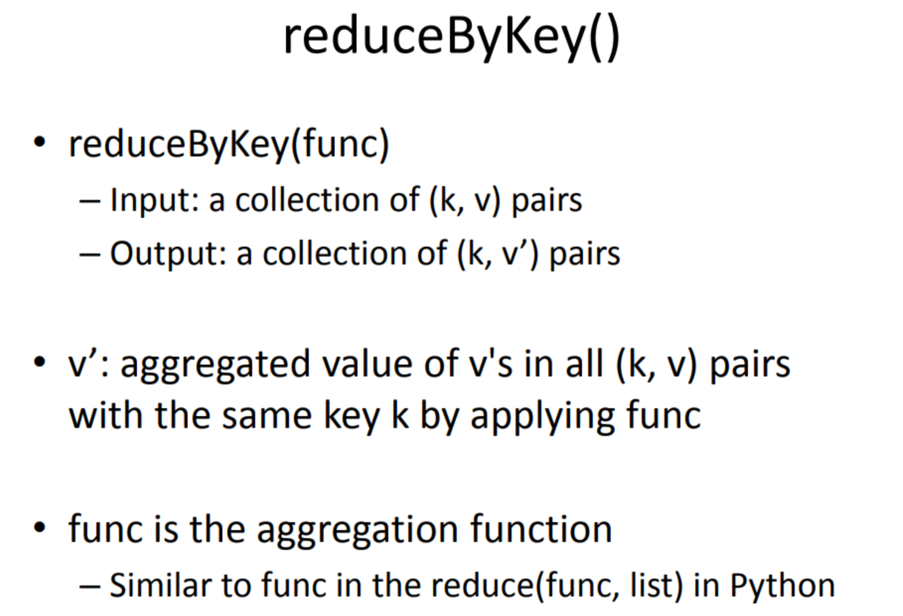

Slide 50
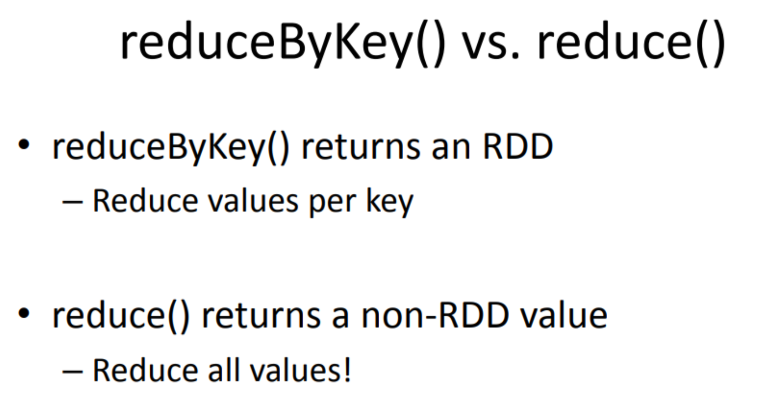

Slide 51
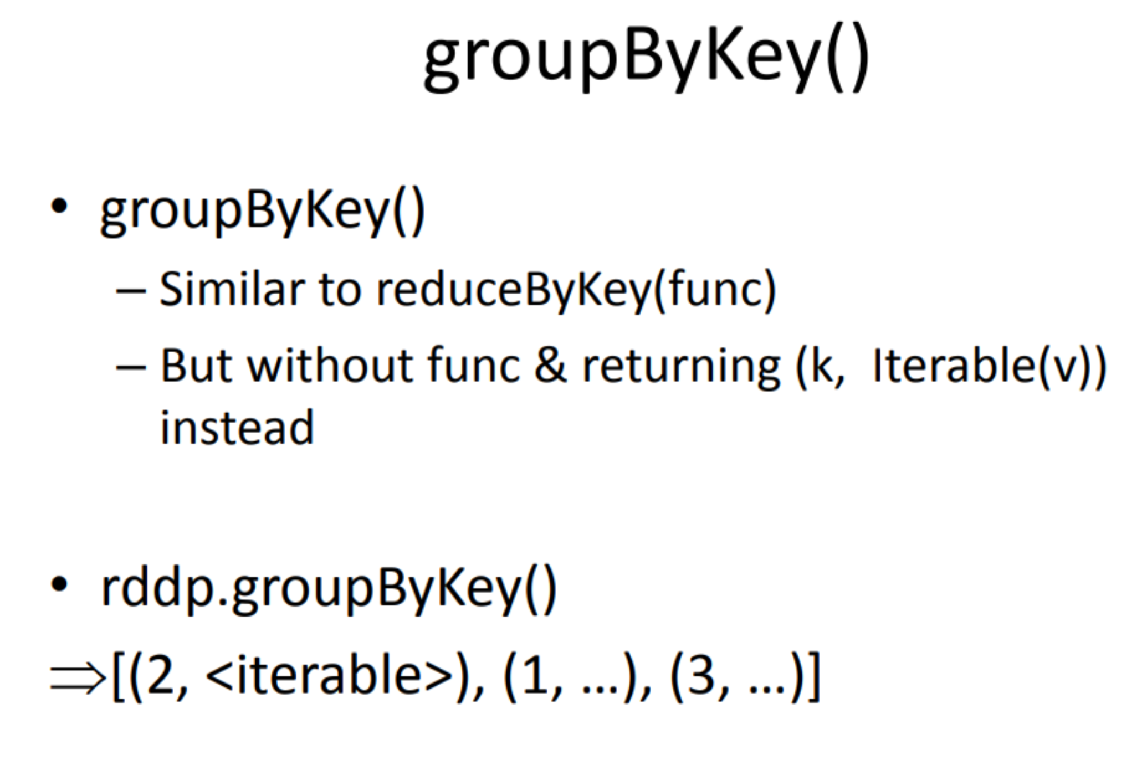

Slide 52
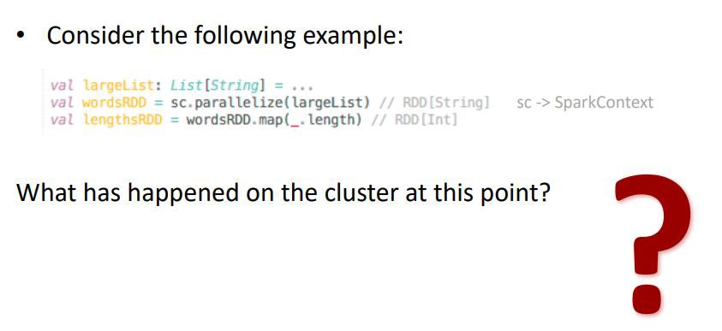
Laziness Example

Slide 53
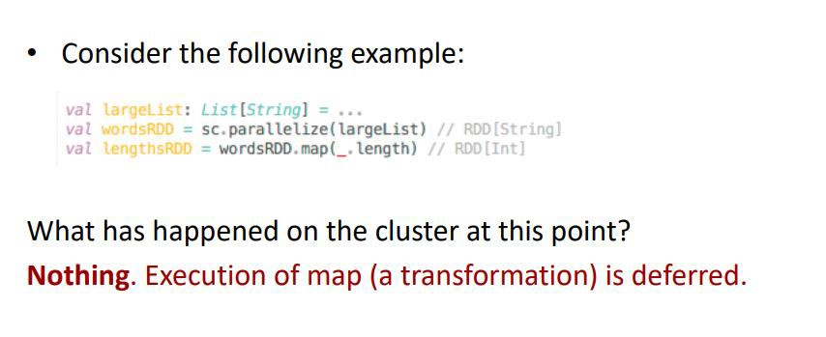
Laziness Example

